Slide 1
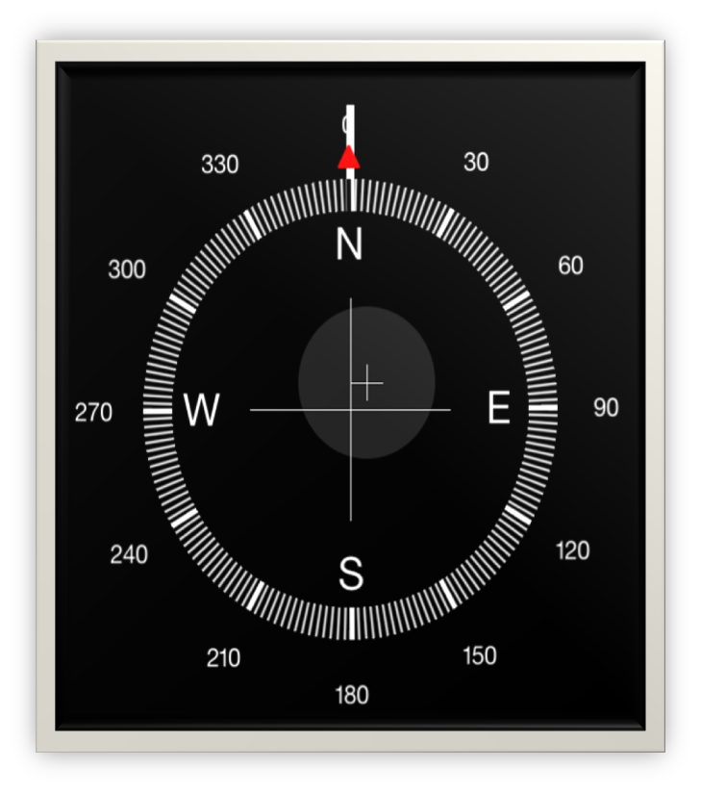
COMPASS EXERCISE

Slide 2
COMPASS EXERCISE
NORTH:
The North Star represents a guiding light, and stabilizing force.
Who do I know that loves me deeply
and guides me?
What do I know about God that
strengthens me?
Proverbs 3:5-6

Slide 3
COMPASS EXERCISE
EAST:
The direction of the rising sun.
This is the place of new beginnings.
Where am I sensing God wanting me to embrace something new?
How can I move in that direction?
Isaiah 43:19

Slide 4
COMPASS EXERCISE
SOUTH:
The direction of the sunny exposure of the sun. Sunlight gives us energy for imagination and play.
Ephesians 3:20
What energizes me?
Where do I find rest & renewal?
What am I longing to do that I haven’t?
What is fun and memorable for me?

Slide 5
COMPASS EXERCISE
Philippians 3:12-14
WEST:
The direction of the setting sun.
This is the place of endings and letting go.
What do I need to let go of?
What patterns in my life need to end?
Where do I need healing or change?

Slide 6
COMPASS EXERCISE

Slide 7
COMPASS EXERCISE
EAST:
The direction of the rising sun.
This is the place of new beginnings.
NORTH:
The North Star represents a guiding light, and stabilizing force.
Where am I sensing God wanting me to embrace something new?
How can I move in that direction?
Who do I know that loves me deeply
and guides me?
What do I know about God that
strengthens me?
Proverbs 3:5-6
Isaiah 43:19
Philippians 3:12-14
What energizes me?
Where do I find rest & renewal?
What am I longing to do that I haven’t?
What is fun and memorable for me?
What do I need to let go of?
What patterns in my life need to end?
Where do I need healing or change?
Ephesians 3:20
WEST:
The direction of the setting sun.
This is the place of endings and letting go.
SOUTH:
The direction of the sunny exposure of the sun. Sunlight gives us energy for imagination and play.

